Slide 1
Database Design Principles
by wwy

Slide 2
Basic Constraints
ER diagram
3 Normal Form
Objective
Useful Tools
Design Database

Slide 3
Basic Constraints
Primary Key
Foreign Key
Not Null
Unique
Check
Default

Slide 4
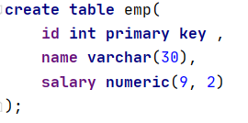
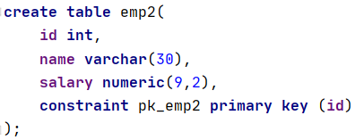
Primary Key
列级约束
表级约束

Slide 5
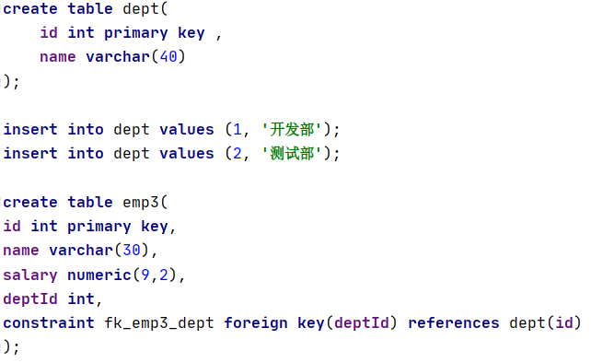
Foreign Key

Slide 6
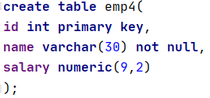
Not Null

Slide 7
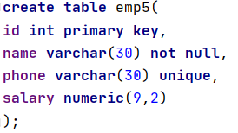
Unique

Slide 8
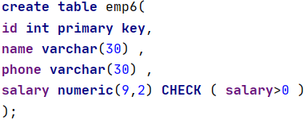
Check

Slide 9
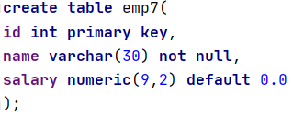
Default

Slide 10
3 Normal Form
1 Normal Form: Singled Valued Attribute
2 Normal Form: No Partial Dependencies
3 Normal Form: No Transitive Dependency
. . . . . .
1NF
2NF
3NF
BCNF
4NF
5NF

Slide 11
1 Normal Form
John has both landline telephone and cellphone
Singled Valued Attribute
Name | Phone Num
Mary | 12345678912
Ben | 0755-12345
eg.
Phone Num
11111 | 98765432199
A
B
No. | Name | Phone Num
1 | Mary | 12345678912
2 | Ben | 0755-12345
3 | John | 0755-11111
4 | John | 98765432199
Name | Landline Num | Cellphone Num
Mary |  | 12345678912
Ben | 0755-12345
John | 0755-11111 | 98765432199

Slide 12
2 Normal Form
No Partial Dependencies
Name | City | Age | Favorite Food | Country
Mary | Bremen | 22 | hamburg | Germany
Ben | Chicago | 23 | hitdog | USA
John | Shenzhen | 22 | yumcha | China
John | London | 24 | Sadwich | UK
eg.
City | Country
Bremen | Germany
Chicago | USA
Shenzhen | China

Slide 13
3 Normal Form
No Transitive Dependency
Name | City | Age | Favorite Food | Country
Mary | Bremen | 22 | hamburg | Germany
Ben | Chicago | 23 | hitdog | USA
John | Shenzhen | 22 | yumcha | China
eg.
City | Country
Bremen | Germany
Chicago | USA
Shenzhen | China

Slide 14
THX ;-)

